Slide 1
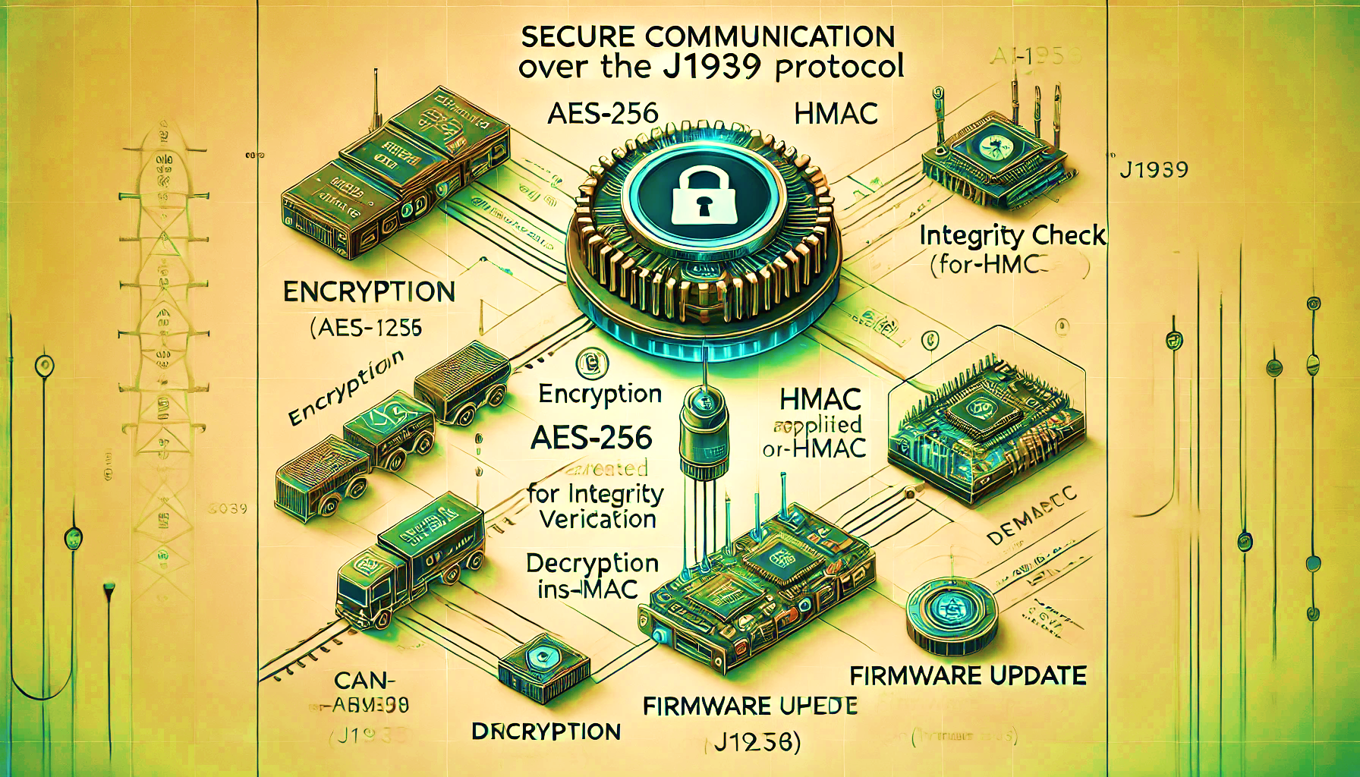
AI Generated
J1939 Secure Communications
SockBurst

Slide 2
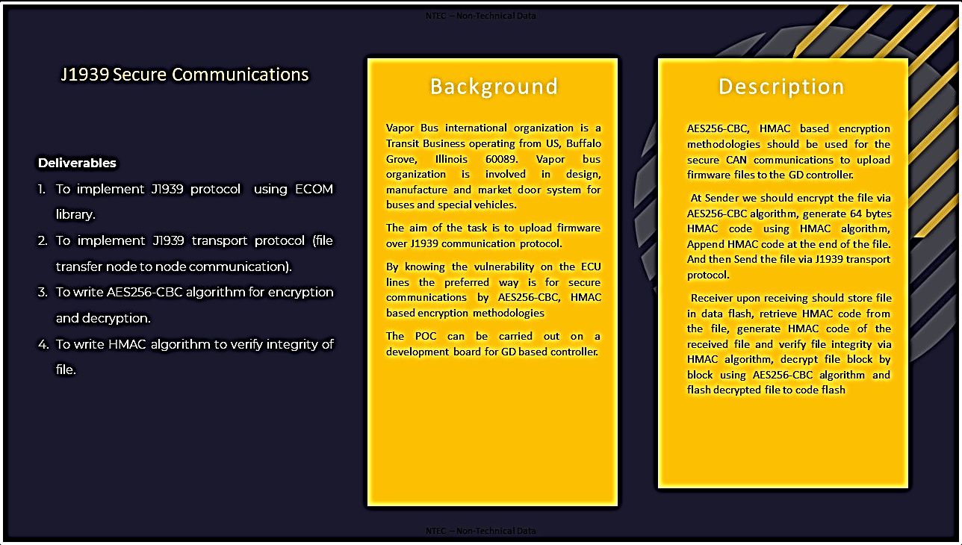
Slide 2 of N

Slide 3

Our design implementation and Approach.
Slide 3 of N

Slide 4

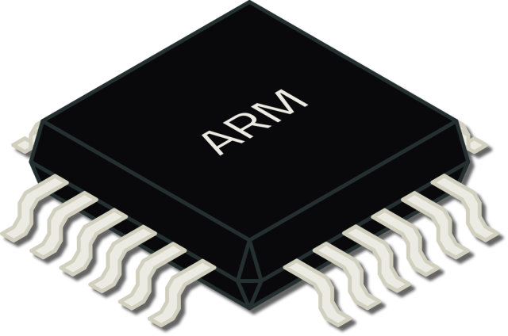


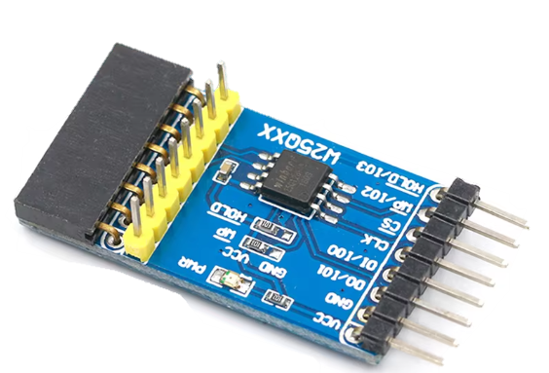
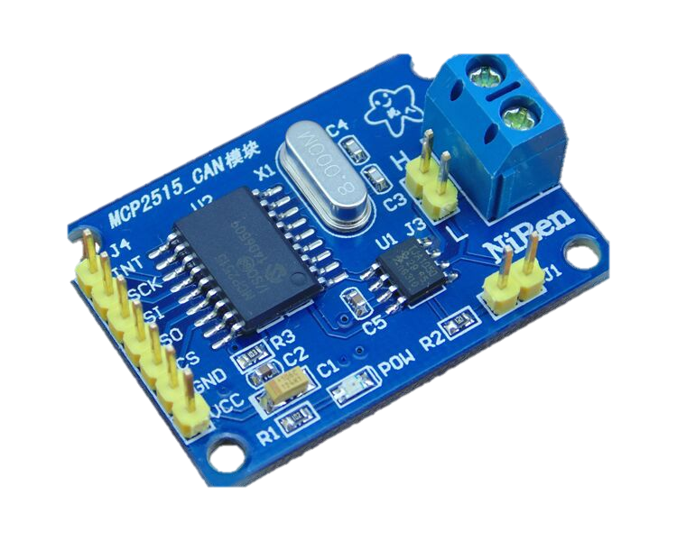

Controller Area Network Block Diagram
Nucleo-STM32F401RE
512KB flash
96KB SRAM
Nucleo-STM32F401RE
512KB flash
96KB SRAM
Node
Receiver
Node
Programmer
SPI
SPI
USB bridge
SPI
SPI
Data flash
MCP2515
Data flash
MCP2515
CAN
CAN
Slide 4 of N

Slide 5
MCP2515 CAN Bus module
Receives Binary signals
from MCU and converts them into differential CAN signals and vice-versa.
CAN
SPI
SPI
Power machine like x86/x86-64/ARM running Linux.
Performs the AES256-CBC encryption and HMAC calculations.
Flashes it onto Data flash using ‘dd’ utility.
Nucleo-STM32F401RE
512KB flash
96KB SRAM
Nucleo-STM32F401RE
512KB flash
96KB SRAM
SPI
Node
Node
Receiver
Programmer
USB bridge
SPI
Receiver node, typically
STM32F401 microcontroller executing CAN-J1939 protocol stack, security algorithms and flash update routines.
Secured firmware will be stored into this Data flash and then any required algorithms will be executed on it.
Programmer node, typically STM32F401 microcontroller executing CAN-J1939
Protocol stack.
Reads secured firmware from Data flash.
Stores the secured firmware generated by power machine.

Slide 6

Data flash flashing with secured firmware :
Data flash can be flashed easily with secured firmware using ‘dd’ utility which is available on Linux.
But flashing the firmware is not enough alone, we‘ve to explicitly tell the programmer node about the size of the firmware, this can be done by storing the firmware size in initial 4 bytes of the last sector of the data flash, following steps can be executed to make Data flash ready for deployment.
A C program can be used for this purpose which just need the firmware file, it will calculate its size, then write it to a .bin file and then execute the ‘dd’ utility to write to the Data flash, Completion of this program means the Data flash can be used for firmware updates.
‘dd’ utility syntax :
dd if=input_file of=/dev/sdX bs=512 seek=sector_number count=1

Slide 7
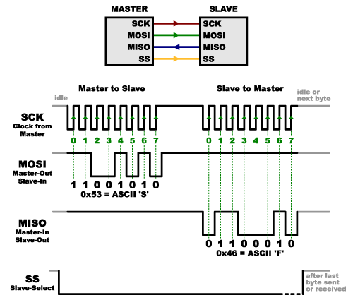
SPI (Serial Peripheral Interface) protocol :
SPI protocol is used intensively in our implementation, SPI serves as interconnect between MCU and CAN bus module, MCU and Data flash.
Before using the SPI protocol, underlying SPI hardware must be configured. In our implementation, MCU acts as master thus provides clock for the communication and MCP2515 CAN bus module acts as slave.
Since SPI is full duplex communication protocol, thus as master clock
pulses, both master and slave shifts out data on SPI bus bit by bit in
synchronization with clock pulses, this leads to exchange of dummy
bytes even during transfer of useful data, thus the high-level software (HAL in conjugation with firmware) must handle and parse the received bytes to filter off relevant data and discard the dummy bytes, this software implementation totally depends on slave device architecture like how it accepts commands, arguments and sends out requested data.
SPI protocol itself doesn’t handle data parsing and filtering.
SPI : Data-link layer
protocol / L2 protocol
USB bridging will connect the SPI based data flash to the computer via a SPI to USB inter-converter, on USB side. Linux will take care of programming.

Slide 8
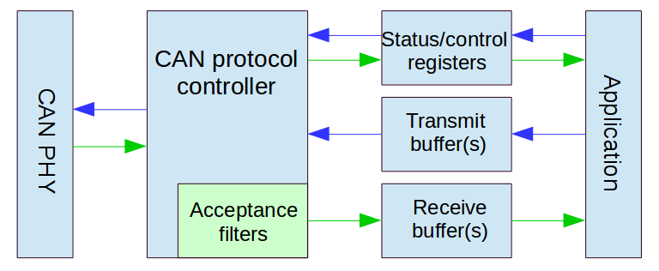
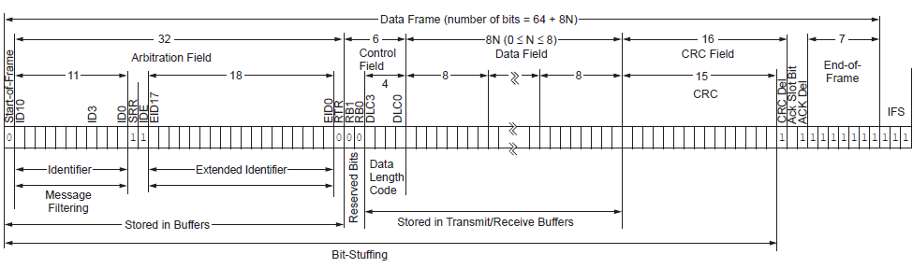
CAN(Controller Area Network) protocol :
CAN has multiple variants like CAN 2.0A, CAN 2.0B, CANopen etc, we’ll be using CAN 2.0B (extended CAN) which has 29 bits identifier field, Its backward compatible with CAN 2.0A as well.
Data-link layer implementation is handled by MCP2515 CAN bus
module which sends out data to other nodes on top of CAN bus
encapsulated in CAN frame, size of this CAN frame depends on choice of CAN variant, for CAN 2.0B, size of each frame excluding
Interframe space is typically 128 bits.
CAN is multi-layered protocol spanning physical and data-link layers.
Extended data frame, SRR and IDE always 1, RTR depends on whether frame contains data (0) or data request (1).
Each CAN frame carries only 8 bytes of data and since we’re using J1939 on top of CAN, thus Data[0] will be used by J1939 Transport layer for frame sequencing, thus only 7 byte of firmware data will be transferred per CAN frame, since only 1 byte is used for frame sequencing, thus one J1939 packet can hold max up-to 1785 bytes (7*255).

Slide 9

J1939 Protocol :
J1939 is core industrial protocol used in large machineries and automotive vehicles. J1939 uses CAN as its physical layer protocol to ensure communication, the application layer of this maps the data and ID into a buffer which is then passed to the transport layer which in turn write the relevant data of CAN frame like 29 bits ID, 8 bytes data, IDE and RTR bits and then sets transmission request bit in ‘TXRTSCTRL’ register using MCP2515 drivers.
Application layer is responsible for handling type of data being sent (PGN), Receiver/Transmitter node address, node address management using networking layer, decision making for transport layer handler type (broadcast/P2P).
Transport layer is skipped if the size of data to be sent is 8 bytes or less, in this scenario, application layer will directly call MCP2515 drivers to transport the data. In our case, the entire data has to be grouped into multiple J1939 packets since J1939 allows addressing up-to 255 frames for each packet because of the protocol design.
J1939 is multi-layered protocol spanning Application layer and transport layer, though spans some part of Networking layer as well via node addressing.
Transport layer handlers are of two types, BAM (Broadcast Announcement Message) and CMDT (Connection Mode Data transfer). As per our deliverables, we need to implement CMDT for node-to-node file transfer.

Slide 10
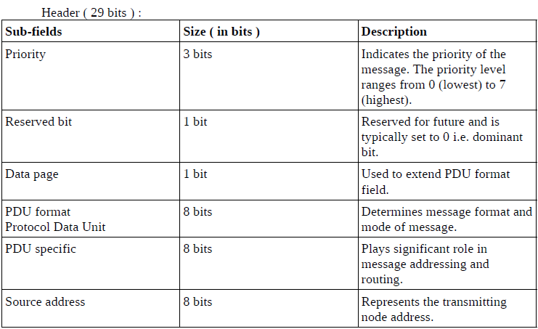
J1939 Application layer :
J1939 packet has two fields, header field(29 bits) and data field(0-1785 bytes), this layer one-to-one maps the header field to extended CAN ID.
Let’s look at this header field :
Header field is generated by application layer depending on type of information the underlying CAN frame will be carrying.
PGN is an important parameter which plays key role in message identification, routine and addressing, it’s a collective field of size 18 bits(needs 5 hex digits) spanning reserved bit, data page bit, PDU format bits, PDU specific bits, thus it can be derived from CAN ID but vice-versa needs additional information like priority bits, source address etc.
PDU Specific field represents Destination ECU address if the PDU format field lies in range [0x00, 0xEF] because only these value represents node specific messages, other values corresponds to different types of broadcast messages, In this case, PS field works as group extension for PF field for
addressing more broadcast message types.
(PF)
(PS)
PGN e.g. : 0x(p)(qr)(st)
RB and DP
PF
PS
PGN = (RB<<10) | (DP<<9) | (PF <<8) | (0x00)
If PS <= 0xEF since PS corresponds to receiver ECU address.
PGN = (RB<<10) | (DP<<9) | (PF<<8) | (PS)
If PS > 0xEF since PS doesn’t represents any ECU address.
If PF <= 0xEF
PGN = 0x(p)(qr)(00), PS = Destination address

Slide 11
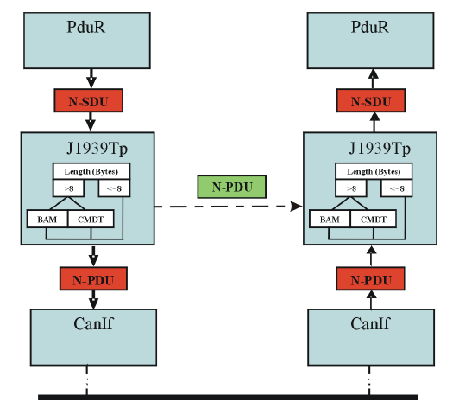
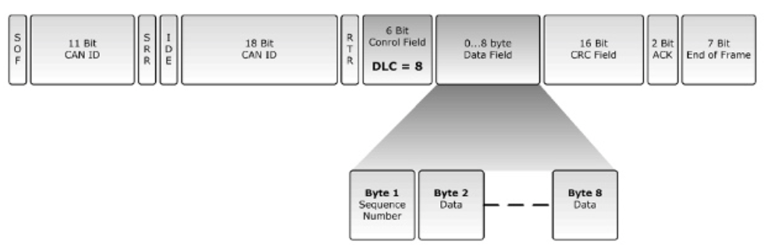
CMDT (Connection Mode Data Transfer) :
The Connection Mode Data Transfer (CMDT) protocol is used when data needs to be transferred to a specific destination, often in a request-response scenario. It involves handshaking between the sender and receiver to control the flow of the message. the CMDT protocol uses the Connection Management (TP.CM) and Data Transfer (TP.DT) frames. It includes additional frames for managing the handshake between sender and receiver.
In TP.CM, there are 4 type of frames(each carry different information) (PGN : 0xEC00):
> CMDT TP.CM_RTS ( Request To Send ) (send by programmer)
> CMDT TP.CM_CTS ( Clear To Send ) (send by receiver)
> CMDT TP.CM_EOM_ACK ( End Of Message ACK )
> CMDT TP.CM_ABORT
In TP.DT, only one type of frame is there (PGN : 0xEB00):
> CMDT TP.DT (Data frame)
Each of these frames have same header field but different data field.
Since TP.CM are specific frames for connection management, thus have
specific PGNs which is fixed (PGN : 0xEC00 (PF<=0xEF -> PS=0x00)), look at
the PGN list here for more details.
J1939 Transport layer interactions

Slide 12
TP.CM/DT data field structures :
TP.CM_RTS :
Byte 0 : Control byte (0x10) (RTS)
Byte 1-2 : Data size (upper limit 1785 bytes)
Byte 3 : Total frame count (Data_size/7)
Byte 4 : Frame count the sender can send in one go
Byte 5-7 : PGN for data being transferred in TP.DT frames
TP.CM_CTS :
Byte 0 : Control byte (0x11) (CTS)
Byte 1 : No. of packet receiver can accept in one go
Byte 2 : Sequence number of next frame (used for
continuation of communication after an interval)
Byte 3-4 : Reserved
Byte 5-7 : PGN for data being transferred in TP.DT frames
TP.CM_EOM_ACK :
Byte 0 : Control byte (0x13) (EndofMsgACK)
Byte 1-2 : Total number of bytes received
Byte 3 : Total frames received
Byte 4 : Reserved
Byte 5-7 : PGN for data being transferred in TP.DT frames
TP.CM_ABORT :
Byte 0 : Control byte (0xFF) (connection abort)
Byte 1-2 : Connection abort reason
Byte 3-4 : Reserved
Byte 5-7 : PGN for data being transferred in TP.DT frames
TP.CM_RTS :
Byte 0: Frame sequence.
Byte 1-7 : Actual data in chunks of 7 bytes.
Networking layer in J1939 protocol stack offers node addressing capabilities like run-time node identity modification, node deletion etc. More details about J1939 protocol stack can be found here.
J1939 protocol stack block diagram is given on next slide.

Slide 13
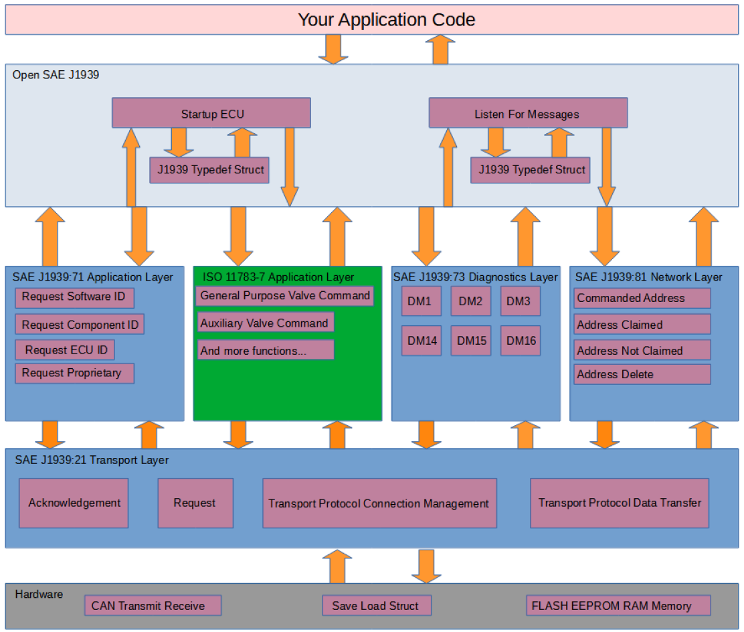

Slide 14
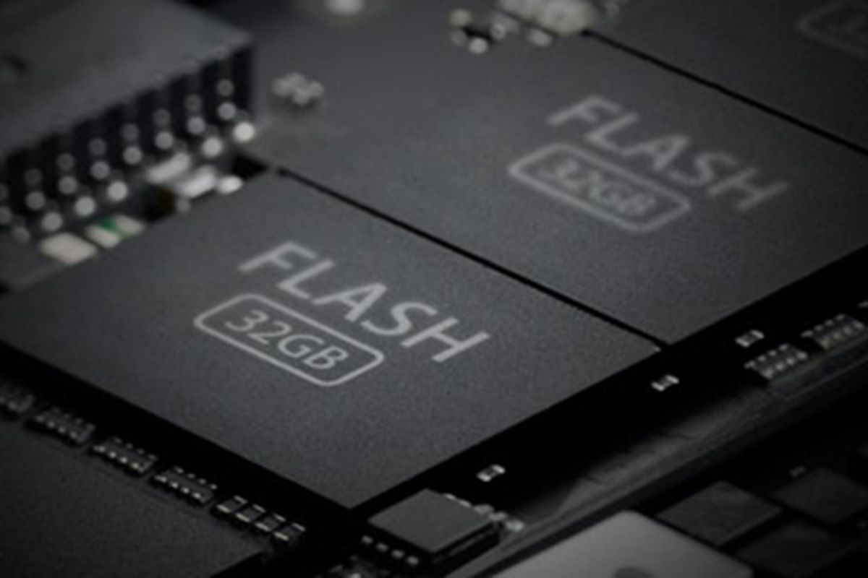
Usage of peripherals, design and implementation depends on the choice of firmware design for both “Programmer” and “Receiver” node.
Let’s discuss how the firmware is designed on both nodes ensuring flawless communication and firmware updates.
Programmer node firmware design and memory layout :
System initialization, peripheral initialization, CAN-J1939 communication routines.
(.text section)
Program data
(.data section)
(load region)
Contains system and user data
I V T
Read only data
(.rodata section)
This firmware design is fixed until some more functionalities are not needed to be added, only secured firmware will change depending on the functionality need to be updated on receiver node.
Flash layout and .bin file structure
0x0800-0000
0x0807-FFFF
512 KBs
The secured firmware will be sent in chunks of 1785 bytes by reading it from Data flash to SRAM and then will be sent over CAN-J1939 Protocol to the receiver node, this ensures sufficient processing time for receiver node to process the data and re-assemble it into Data flash.
Block size of 1785 bytes is chosen to tackle the problem with J1939 CMDT transport layer handler, it provides only 1 byte to frame sequencing, thus any block size larger than 1785 will cause an overflow situation.

Slide 15
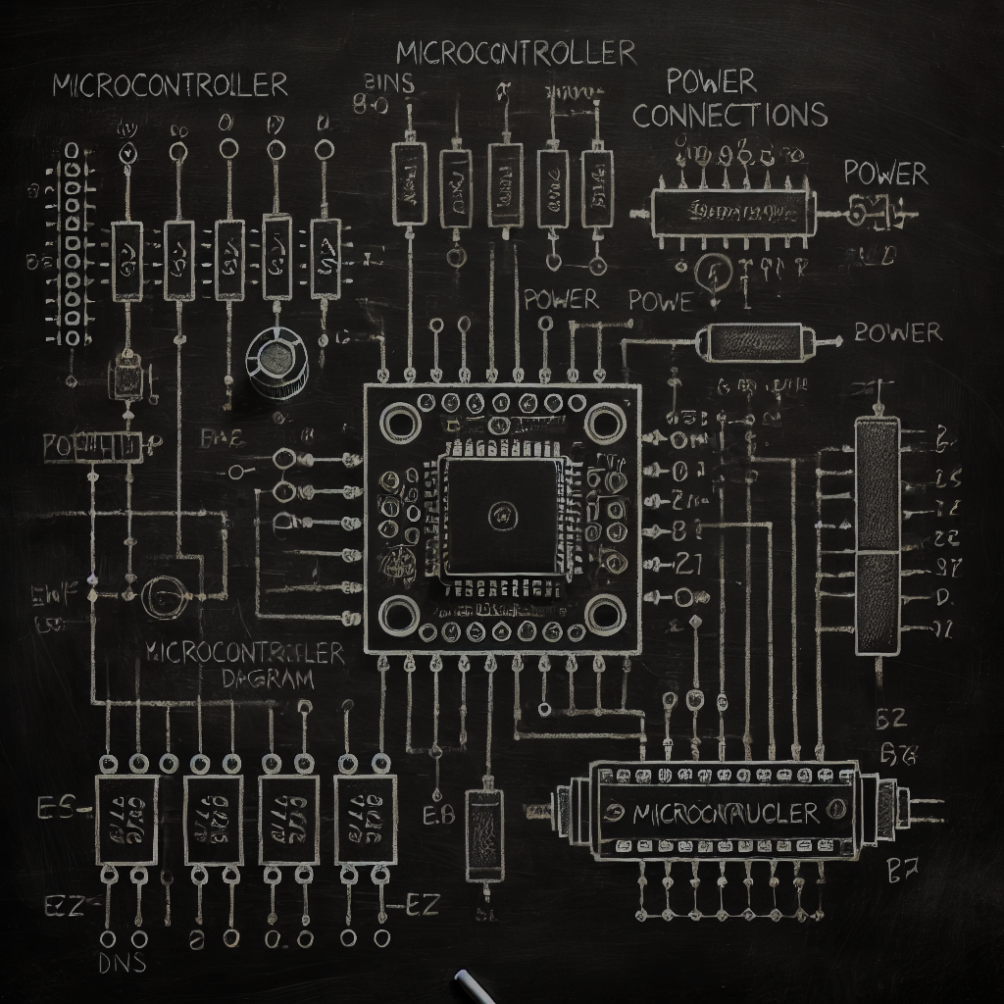

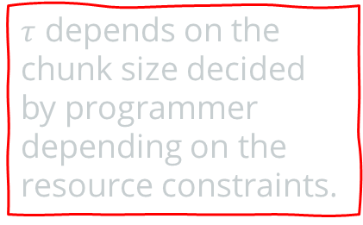

Time domain chart for communication initialization and processing :
Communication begin
CAN-J1939 communication initialization
Secured firmware transfer in chunks (1785 B)
Programmer MCU
Receiver MCU
Processing period, no data transfer
Secured firmware transfer in chunks (1785 B)
$$τ$$
Processing period, no data transfer
Time
Cycle continues till entire firmware transfer
$τ$ depends on the chunk size decided by programmer depending on the resource constraints.
Communication end
This time–domain diagram represents ideal communication scenarios ignoring real-world problems like power failures or unpredictable system resets.
Such scenarios are handled for communication state recovery by triggering a query to the receiver node which in turn responds with its communication state information.

Slide 16
More details of programmer firmware.
System initialization, peripheral initialization, CAN-J1939 communication routines.
(.text section)
Program data
(.data section)
(load region)
Contains system and user data
I V T
Read only data
(.rodata section)
0x0800-0000
0x0807-FFFF
Typical ISR routine addresses like NMI, hard fault, EXTI for MCP2515 etc.
Program data like J1939 structures, CAN structures and others which will be copied to SRAM during system initialization by startup code.
System clock Initialization at 16MHz, SPI1 initialization at 8MHz (for MCP2515), SPI2 initialization at ‘X’MHz (for Data flash).
Read only data like constant addresses for memory and register access.

Slide 17
Exclusive properties of programmer node firmware :
Auto communication state recovery on receiver’s instruction offering resumed and robust communication across power failures and system resets. This is done during CAN-J1939 initialization with a firmware transfer query using extended remote frame, triggered by programming node, receiver node will respond with command instructing fresh or resumed firmware transfer.
Strict usage of static memory allocation avoiding run-time memory allocation and fragmentation issues, ensuring compatibility with industrial standards like MISRA C.
Avoids unnecessary resource usage on programmer node by doing security algorithm computation on PC, this allows the programmer node to be chosen with limited resources that can handle CAN-J1939 protocol stack only.
block0
Programmer’s communication state recovery query
If
command
block1
While(1)
get_block()
block2
block3
Receiver’s command
!command
block(N-2)
block(N-1)
Communication state recovery
block(N)

Slide 18
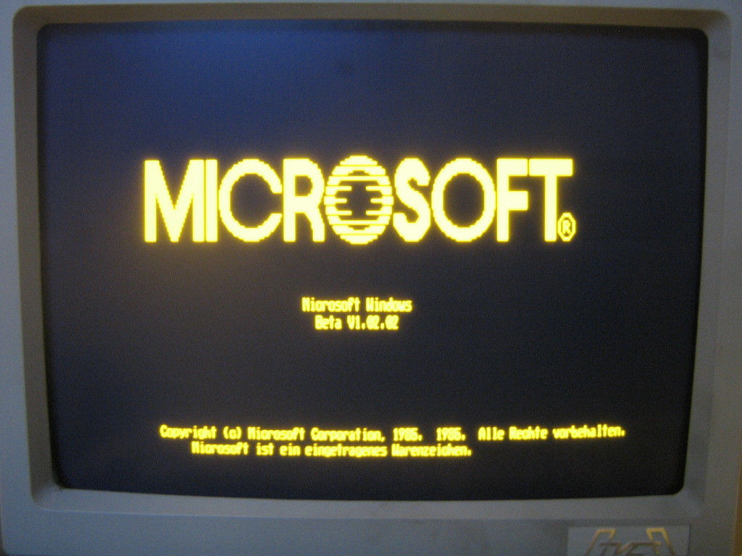
Programmer node boot-up and program flow :
Direct booting from flash memory by boot pins configuration on MCU.
Low level hardware initialization by Reset handler.
Jumping to main firmware for firmware transfer.
Communication state recovery information exchange between programmer and receiver nodes.
Programmer nodes enters low power state after ‘disconnecting peripherals from supply’/’ firmware transfer’.

Slide 19
Receiver node firmware design and memory layout :
Creating a usable Receiver MCU :
All ECUs to be used in industrial machineries/automatic vehicles must be first flashed with a special firmware called “Custom Bootloader” which offers robust and reliable firmware update state recovery across power failures and system resets.
All security algorithms and update routines are implemented in this custom bootloader.
Let’s look at the memory layout of this custom bootloader.
Program data
(.data section)
(load region)
Contains system and user data
IVT : basic ISRs like NMI, hard faults etc.
.text : contains routines for security applications (AES and HMAC) and update routines.
.rodata : contains security algorithm data like KEY/IV/S boxes/Constant matrices.
.data : contains modifiable data for bootloader like subsequent IVs.
System initialization, SPI initialization, firmware update, pseudo File System routines.
(.text section)
I V T
Read only data
(.rodata section)
0x0800-0000
0x0807-FFFF
512 KBs
SRAM layout for this custom bootloader will be similar to that of programmer node since SRAM generally contains stack, .data and .bss and its enough for our implementation.

Slide 20
Exclusive properties of receiver node custom bootloader :
Handles the firmware security execution and updates avoiding repetitive inclusion in new firmware on each update, independent of the underlying communication mechanism for firmware transfer, thus can be used with other physical layer protocols.
Auto-recovery of firmware update state offering robust and resumed firmware update including both security execution and flashing. This is done via a system reset by the receiver node on firmware transfer completion (now the firmware is in receiver’s Data flash), on reset, bootloader checks for pending system updates by reading a sector of Data flash which store system state information for firmware updates, thus offering reference for the new firmware development which must be strictly followed.
Binds SPI communication routines into it, thus receiver firmware can directly use the addresses of those routines to communicate over any SPI channel.
Strict usage of static memory allocation avoiding run-time memory allocation and fragmentation issues, ensuring compatibility with industrial standards like MISRA C.
Pseudo file system implementation for Data flash offering high level APIs to interact with Data flash, receiver node firmware must use these APIs via function pointers to interact with Data flash, though low-level access is also allowed using SPI drivers. This API is designed such that even access to the bootloader critical fields in data flash from firmware doesn’t corrupts any information because bootloader fields are used during firmware update only.
Configures the system into a knows state like configuring system clock etc which need not to be done by firmware again unless explicitly needed.
pFS APIs are designed in a way that the firmware region can be used to store some other large data via the same routine(must be done with caution)
.bin file flashing capabilities avoiding records/data parsing, thus speeding up the flashing process. Also .bin file is typically very small in size as compared to .hex file.
Ensures that SRAM, prefetch buffer and caches (both ‘i’ and ‘d’ caches)

Slide 21
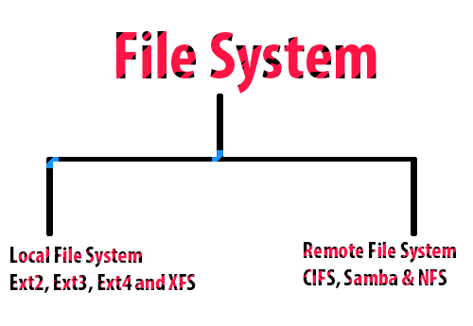
Data organization and pseudo file system
implementation on receiver’s Data flash :
Data flash on receiver node stores critical information without which the entire implementations seems to be uncompleted. Along with the received firmware, it stores critical system state recovery information for both communication and update processes.
All the information and firmware which is stored in receiver’s Data flash
Is stored in an organized way.
This FS contains only 2 sections for now (can be extended in future),
Sector 0 : keeps update and communication state recovery information.
Sector 1-N : received firmware/user data
This FS offers an API which the firmware can use to access the Data flash in a systematic and secure manner.
Sector 1 is used to store general communication state recovery information, not just for CAN-J1939 protocol, though the idea is to use this sector for communication state information for firmware transfer only but can be extended to general use.

Slide 22
0x00…0
Data flash Sector size : 512 Bytes
0xFF…F
Sector 0
Secured firmware with IV and HMAC code.
Sector 2 – Sector N
0x0000
Byte to be filled by firmware before reset for bootloader to execute security and update routines.
(uint8_t)
Byte 0
Byte 1-4
Byte 5-8
Contains critical information for system state recovery during firmware update.
Byte 9-24
Bytes used by bootloader itself
for storing the security progress/check-points. (uint32_t)
Byte 25-28
Byte 29-32
Bytes used by bootloader itself
for storing the firmware update progress/check-points.
(uint32_t)
Bytes used by firmware to store the communication state like 1785B block count. (uint32_t)
Byte 33-36
AES256-CBC IV
(uint8_t*)
Firmware address in data flash, must be set for updating the firmware. (uint32_t)
Entire Firmware size received at beginning. (uint32_t)
0x01FF

Slide 23
More about custom bootloader :
Placed in “pFS” section for being used by firmware
typedef struct {
void (*Read)(uint8_t*, uint32_t)=read;
void (*Write)(uint8_t*, uint32_t)=write;
} pFS_ops ;
Placed in “Spi” section for being used by firmware
Program data
(.data section)
(load region)
Contains system and user data
System initialization, SPI initialization, firmware update, pseudo File System routines.
(.text section)
typedef struct {
/**
* appropriate pointers to
* SPI routines.
*/
} SPI_ops ;
I V T
Read only data
(.rodata section)
// FS API collection.
void read(uint8_t* addr, uint32_t size);
void write(uint8_t* addr, uint32_t size);
0x0800-0000
0x0807-FFFF
Only read-write access is provided to data flash via this API,
Any IOCTL can be carried out by allocating a ‘SPI’ structure and passing it to the exposed SPI routines in firmware.
512 KBs
// SPI routines collection

Slide 24
Bootloader execution with power failure persistence and control transfer to firmware :
Power on
Resuming firmware update
Clearing byte 0 of sector 0
Initializes system with clock and SPI1 configuration
Byte 0 set
Firmware update state recovery
Reading Byte 0 of sector 0
Byte 0 not set
HMAC integrity verification
System reset
Jumping to firmware
AES256-CBC decryption
Power failure
firmware
Starting fresh firmware update
Clearing byte 0 of sector 0

Slide 25

Bootloader’s transition to firmware :
Transition ahead
Disable IRQs
Clear entire SRAM
Relocate IVT
Linker script for receiver firmware must be carefully modified so that the .hex file contains address relative to <>, not 0x0800-0000.
Flush prefetch buffer, ‘i’ and ‘d’ caches.
Jump to firmware
using an assembly
routine avoiding stack-based C routine calling convention.
Receiver’s firmware share similarities with programmer node’s firmware in context of application specific routines, ISRs etc. Initialization routines like clock configuration, SPI 1 initialization etc are handled by the custom bootloader, though resides at some higher address <> instead of 0x0800-0000.
Set stack pointer and Instruction pointer(IP/PC)
Firmware Code (IRQs disabled)

Slide 26
Exclusive properties of receiver node firmware :
Very light weight and application specific only like communicating with peripherals and doing computation. No need to take care of security and update routines each time reducing firmware size, transfer and update time.
Written on top of reference provided by the custom bootloader achieving efficient resource management by avoiding repetitive inclusion of pseudo file system API routines, SPI routines etc.
Strict usage of static memory allocation avoiding run-time memory allocation and fragmentation issues, ensuring compatibility with industrial standards like MISRA C.
Auto communication state recovery by storing number of received blocks(each of 1KB/2KB) into Data flash after copying the block to Data flash from SRAM via the pseudo file system API included in reference provided by custom bootloader, this critical information is sent to programmer node in response to communication state recovery query .

Slide 27
Receiver node firmware execution :
First step of firmware execution after getting processor control is to check whether any communication was pending or not by looking at byte 0-3 (uint32_t) of sector 1, depending on which it responds to communication state recovery query raised by the programmer node. If communication is pending, it will wait for programmer’s query for communication state recovery, else it will continue with its normal operations, it may receive a query from programmer node during its normal operations if byte 0-3 are not marked (this indicates that programmer node is now involved in CAN communication and wants to update it).
Communication will either start from a resumed state or a fresh state, the entire firmware data received during this communication is stored directly into the firmware region of Data flash.
Once the entire firmware has been received, byte 0 of sector 0 is marked using SetUpdate() of pFS API followed by system reset which on next reboot informs custom bootloader to start firmware update. Note that this routine must be used in the firmware data reception handler build on top of J1939 protocol as incorrect usage may trigger an unwanted system update which may lead to data and firmware corruption if not handled properly.

Slide 28
Communication state recovery query and response CAN frame structure :
Query and state response CAN frame will be part of CAN initialization, both these frame will be sent bypassing J1939 transport layer, PGNs of such frames has been decided as 0xFF00 (a Proprietary B PGN), lets look at each’s structure.
0 0 0 0 0 1 1 1 1 1 1 1 1 0 0 0 0 0 0 0 0 0 1 0 0
1
SA
Data field
0x01 | PGN[2] | PGN[1] | PGN[0]
PGN[3] : 0 | PGN[2] : 0xFF | PGN[0] : 0x01
b0 b1 b2 b3 b4 b5 b6 b7
0 0 0 0 0 1 1 1 1 1 1 1 1 0 0 0 0 0 0 0 0 1 1 1 1
SA
Data field
0x02 | Block[3] | Block[2] | Block[1] | Block[0] | PGN[2] | PGN[1] | PGN[0]
PGN[3] : 0 | PGN[2] : 0xFF | PGN[0] : 0x01
b0 b1 b2 b3 b4 b5 b6 b7

Slide 29
Communication begin
Reboot on power failure
Normal communication flow
Recovery decision
Communication state recovery
Programmer MCU
Receiver MCU
$$τ$$
Time
Communication failed due to power failure/system reset
Communication end
Power failure handling during communication

Slide 30
Future add-ons :
Designing Custom bootloader binding all the routines relevant to firmware update like security algorithms, flashing, communication etc, thus isolating and automating the firmware update process making it highly reliable and less error prone(could be used to replace manufacturer bootloader).
Using .sb file (a new type of file developed by team SockBurst) instead of .bin/.hex for firmware transfer, the .hex file will be converted into .sb file resulting in size reduction of firmware.

Slide 31
THE END!
J1939 Secure Communications
Team SockBurst

